Slide 1
Scalp and Face
Prof. Aranjan Karunanayake
MBBS, DM, DOH&S, Dip.Tox, Dipin. Coun, D.Sp.Med, DSEM (UK), FSS (IND), MBASEM (UK), Msc.SEM (UK)

Slide 2
Objectives
Describe the bones of the skull.
Describe the layers of the scalp
Describe the muscles of the face
Describe the arterial, venous, lymphatic and nervous supply to face.
Clinical importance

Slide 3
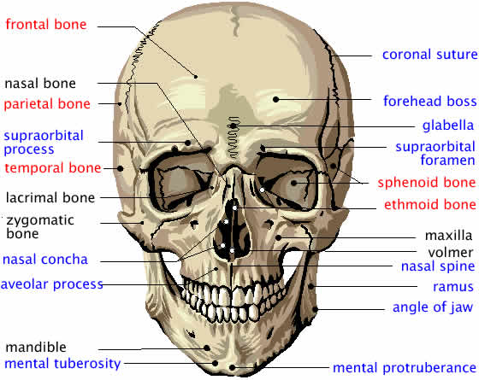
Skull and face
The skull has 22 bones, excluding the ossicles of the ear.
Except for the mandible, which forms the lower jaw the bones of the skull are attached to each other by sutures.
The skull can be subdivided into:
an upper part (the calvaria), which surrounds the cranial cavity containing the brain;
a lower anterior part-the facial skeleton (viscerocranium).

Slide 4
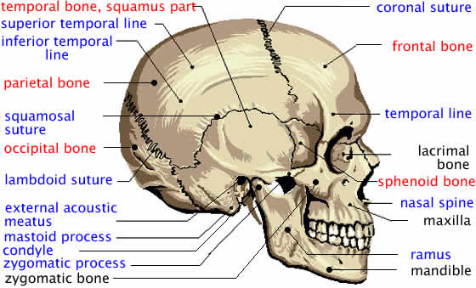
Bones of Calvaria
The bones forming the calvaria are the
Paired –
Temporal
Parietal
Unpaired –
Frontal,
Sphenoid,
Ethmoid,
Occipital bones.

Slide 5
Bones of Face
Paired
Lacrimal
Maxillary
Nasal
Inferior nasal conchae
Palatine
Zygomatic
Unpaired
Vomer
Mandible

Slide 6
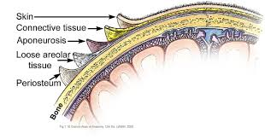
Layers of scalp
S – Skin
C – Subcutaneous tissues
A – Aponeurosis
L – Loose areolar tissues
P - Periosteum

Slide 7
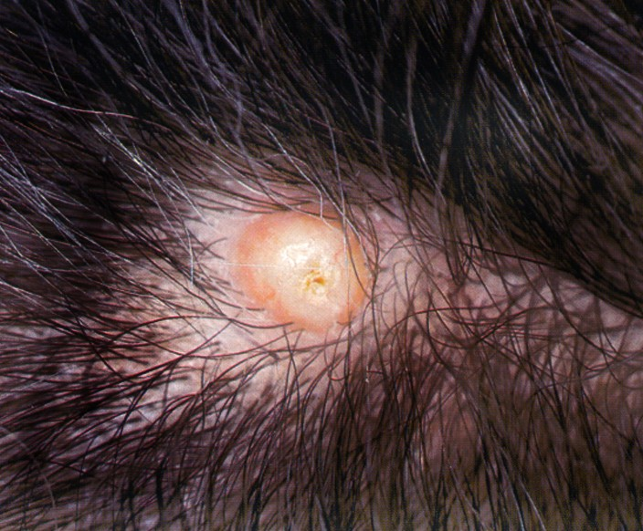
Sebaceous cyst

Slide 8
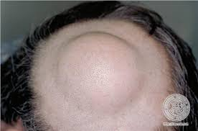
Scalp Lypoma

Slide 9
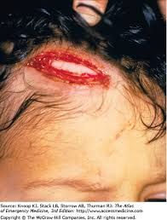
Injury to aponeurotic layer can cause a gaping scalp wound

Slide 10
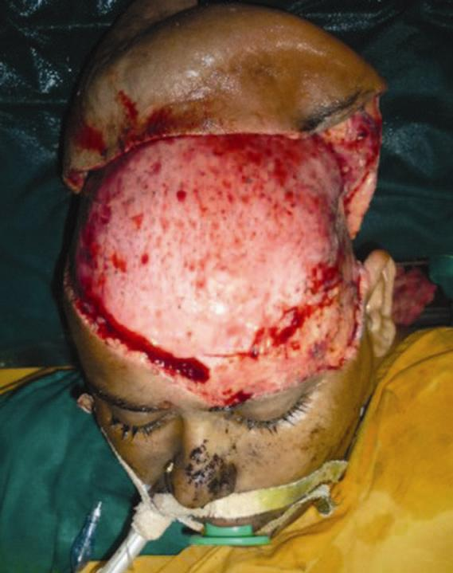
De gloving injury to the scalp

Slide 11
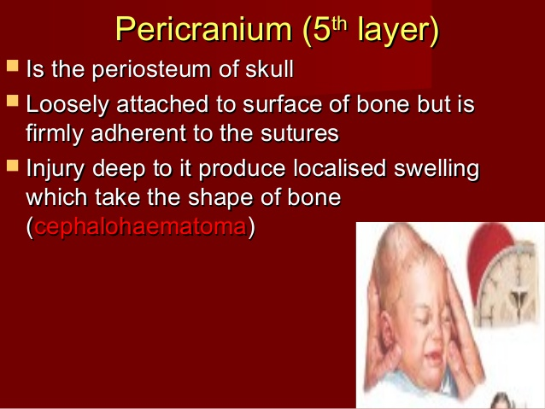
Cephalhaematoma

Slide 12
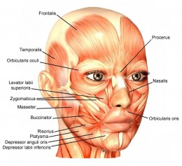
Muscles of Face

Slide 13
Facial Muscles
Muscles of facial
Expression
Subcutaneous muscles.
Inserts on to the subcutaneous tissues.
When contracts shows facial expressions.
Supplied by the facial nerve.

Slide 14
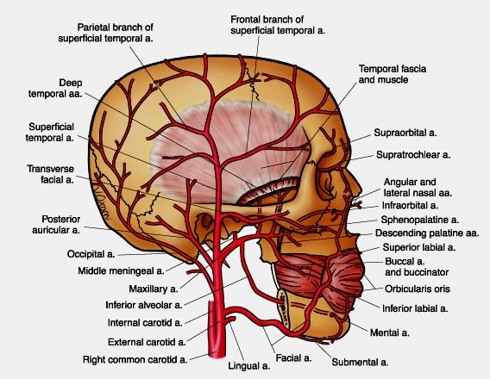
Arterial supply to the face
Rich arterial supply.
Mainly by branches of external carotid artery.
Forehead region is supplied by branches of supra trochlear and supra orbital arteries. They are branches of internal carotid artery.
External carotid supplies the superficial temporal, maxillary and facial.
Face is also site of anastomosis of internal and external carotid arteries.

Slide 15
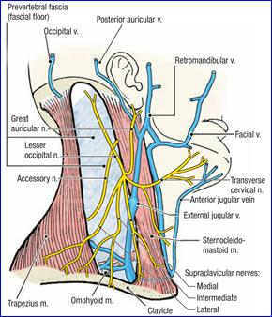
Venous drainage of the face

Slide 16
Venous drainage of the Face
Maxillary and superficial temporal veins join and form the retromandibular vein.
Retromandibular vein has an anterior and a posterior division.
Anterior division and facial vein join and drain into internal jugular vein.
Infections from danger area of face can spread to deep venous sinuses.

Slide 17
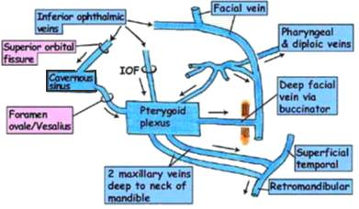
Venous drainage
Superficial veins of the face communicate with deep venous sinuses via emissary veins.
Infections from danger area of face can spread to deep venous sinuses such as pterygoid and cavernous sinuses..

Slide 18
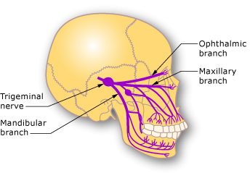
Nerve supply
The sensory supply is mainly supplied by the three branches of trigeminal nerve.
Ophthalmic
Maxillary
Mandibular
Posterior area of scalp is supplied by
Greater occipital,
Lesser occipital
Posterior rami of C3,4,5).

Slide 19
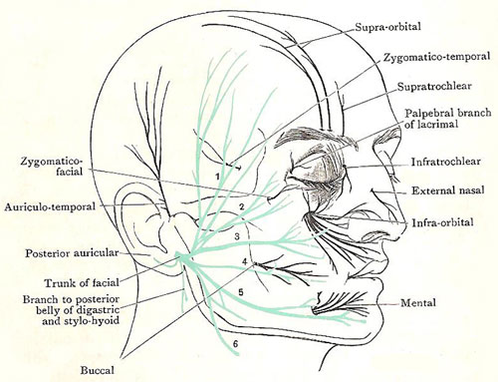
Sensory and motor Nerve supply to the face

Slide 20
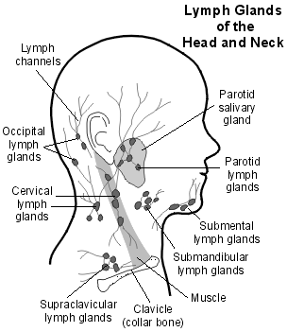
Lymphatic supply
Nodes that may be palpable-
Submental
Submandibular
Parotid
Posterior auricular
Occipital
Mastoid
Cervical
Supraclavicular

